Slide 1
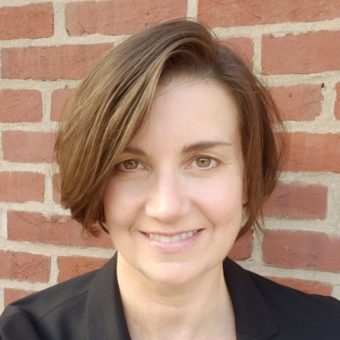
LeeAnne Rogers Senior Consultant – Acceleration
Email
leeanne.rogers@thebridge.com
Location
Harrisburg Area, PA
Mobile
(717) 557-4940
LeeAnne joined The Bridge in June 2024. Her work has spanned numerous industries and functions, including hospital supply chain, program management, public policy research, and communications. She has led cross-functional teams to deliver cost savings, improved population health outcomes, and operational efficiencies for her clients.
EXPERIENCE
Industry Experience
Health Care and Insurance | State and Local Government | Federal Government | Non-Profit
Supply Chain | Health Care
Strategic Sourcing. Provided additional capacity to newly formed Strategic Sourcing team to achieve significant savings in technology products and services. Managed RFP processes, including coordinating cross-functional committees in the review and selection process.
Contract Management. Assisted two merging health care systems to identify opportunities to consolidate vendors, renegotiate pricing or reduce duplicative suppliers to achieve cost savings and operational efficiency.
Program Management | State Government
Client Engagement. Managed complex government health care programs that provided acute and chronic health care management to poor and underserved communities.
Outcomes Management. Led a cross-functional team to monitor and report on program outcomes, including population health improvements, current and future cost savings, and provider performance incentives.
Communications. Developed communications strategies to support the implementation of new policies and procedures, communicate program outcomes to a variety of stakeholders such as advocacy groups, elected officials and members of the media.
BACKGROUND
Functional Skills
Change Management, Organizational Transformation, Strategic Sourcing, Contracting, Program Management, Research and Analysis, Communications, Public Finance
Qualifications
Working with non-profits, Fortune 500 companies and all levels of government, LeeAnne has managed public health programs to improve access to quality care and worked on transformation initiatives that drive operational efficiency and savings. Additionally, LeeAnne has deep experience implementing communications strategies.

Slide 2

Email
leeanne.rogers@thebridge.com
Mobile
(717) 557-4940
Location
Harrisburg Area, PA
LeeAnne joined The Bridge in June 2024. Her work has spanned numerous industries and functions, including hospital supply chain, program management, public policy research, and communications. She has led cross-functional teams to deliver cost savings, improved population health outcomes, and operational efficiencies for her clients.
LeeAnne Rogers Senior Consultant
Acceleration

Slide 3
LeeAnne Rogers Senior Consultant – Acceleration
Email
leeanne.rogers@thebridge.com
Location
Harrisburg Area, PA
Mobile
(717) 557-4940
BACKGROUND
EXPERIENCE
Functional Skills
Change Management, Organizational Transformation, Strategic Sourcing, Contracting, Program Management, Research and Analysis, Communications, Public Finance
Qualifications
Working with non-profits, Fortune 500 companies and all levels of government, LeeAnne has managed public health programs to improve access to quality care and worked on transformation initiatives that drive operational efficiency and savings. Additionally, LeeAnne has deep experience implementing communications strategies.
Industry Experience
Health Care and Insurance | State and Local Government | Federal Government | Non-Profit
Supply Chain | Health Care
Strategic Sourcing. Provided additional capacity to newly formed Strategic Sourcing team to achieve significant savings in technology products and services. Managed RFP processes, including coordinating cross-functional committees in the review and selection process.
Contract Management. Assisted two merging health care systems to identify opportunities to consolidate vendors, renegotiate pricing or reduce duplicative suppliers to achieve cost savings and operational efficiency.
Program Management | State Government
Client Engagement. Managed complex government health care programs that provided acute and chronic health care management to poor and underserved communities.
Outcomes Management. Led a cross-functional team to monitor and report on program outcomes, including population health improvements, current and future cost savings, and provider performance incentives.
Communications. Developed communications strategies to support the implementation of new policies and procedures, communicate program outcomes to a variety of stakeholders such as advocacy groups, elected officials and members of the media.

Slide 4









 | USE OVER DARK BACKGROUND | USE OVER LIGHT BACKGROUND
STRATEGY & ADVISORY
DATA & AI
EXPERIENCES
CLOUD & PRODUCT
ACCELERATION

